Slide 1
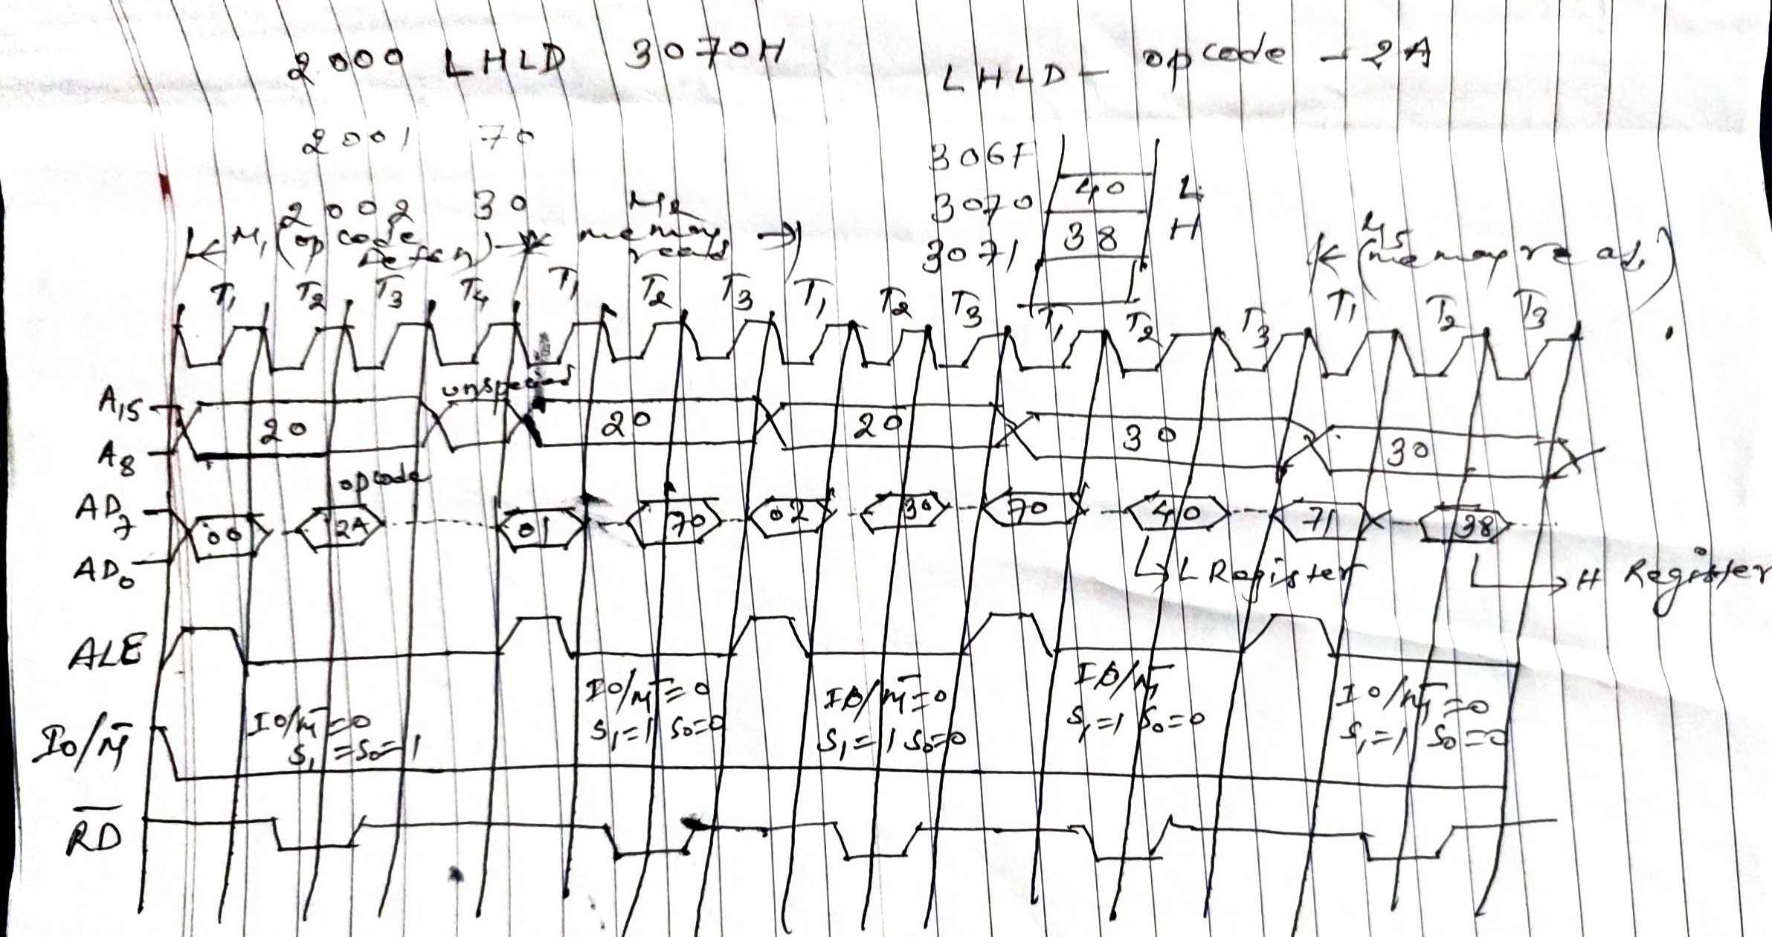
Microprocessor……..

Slide 2
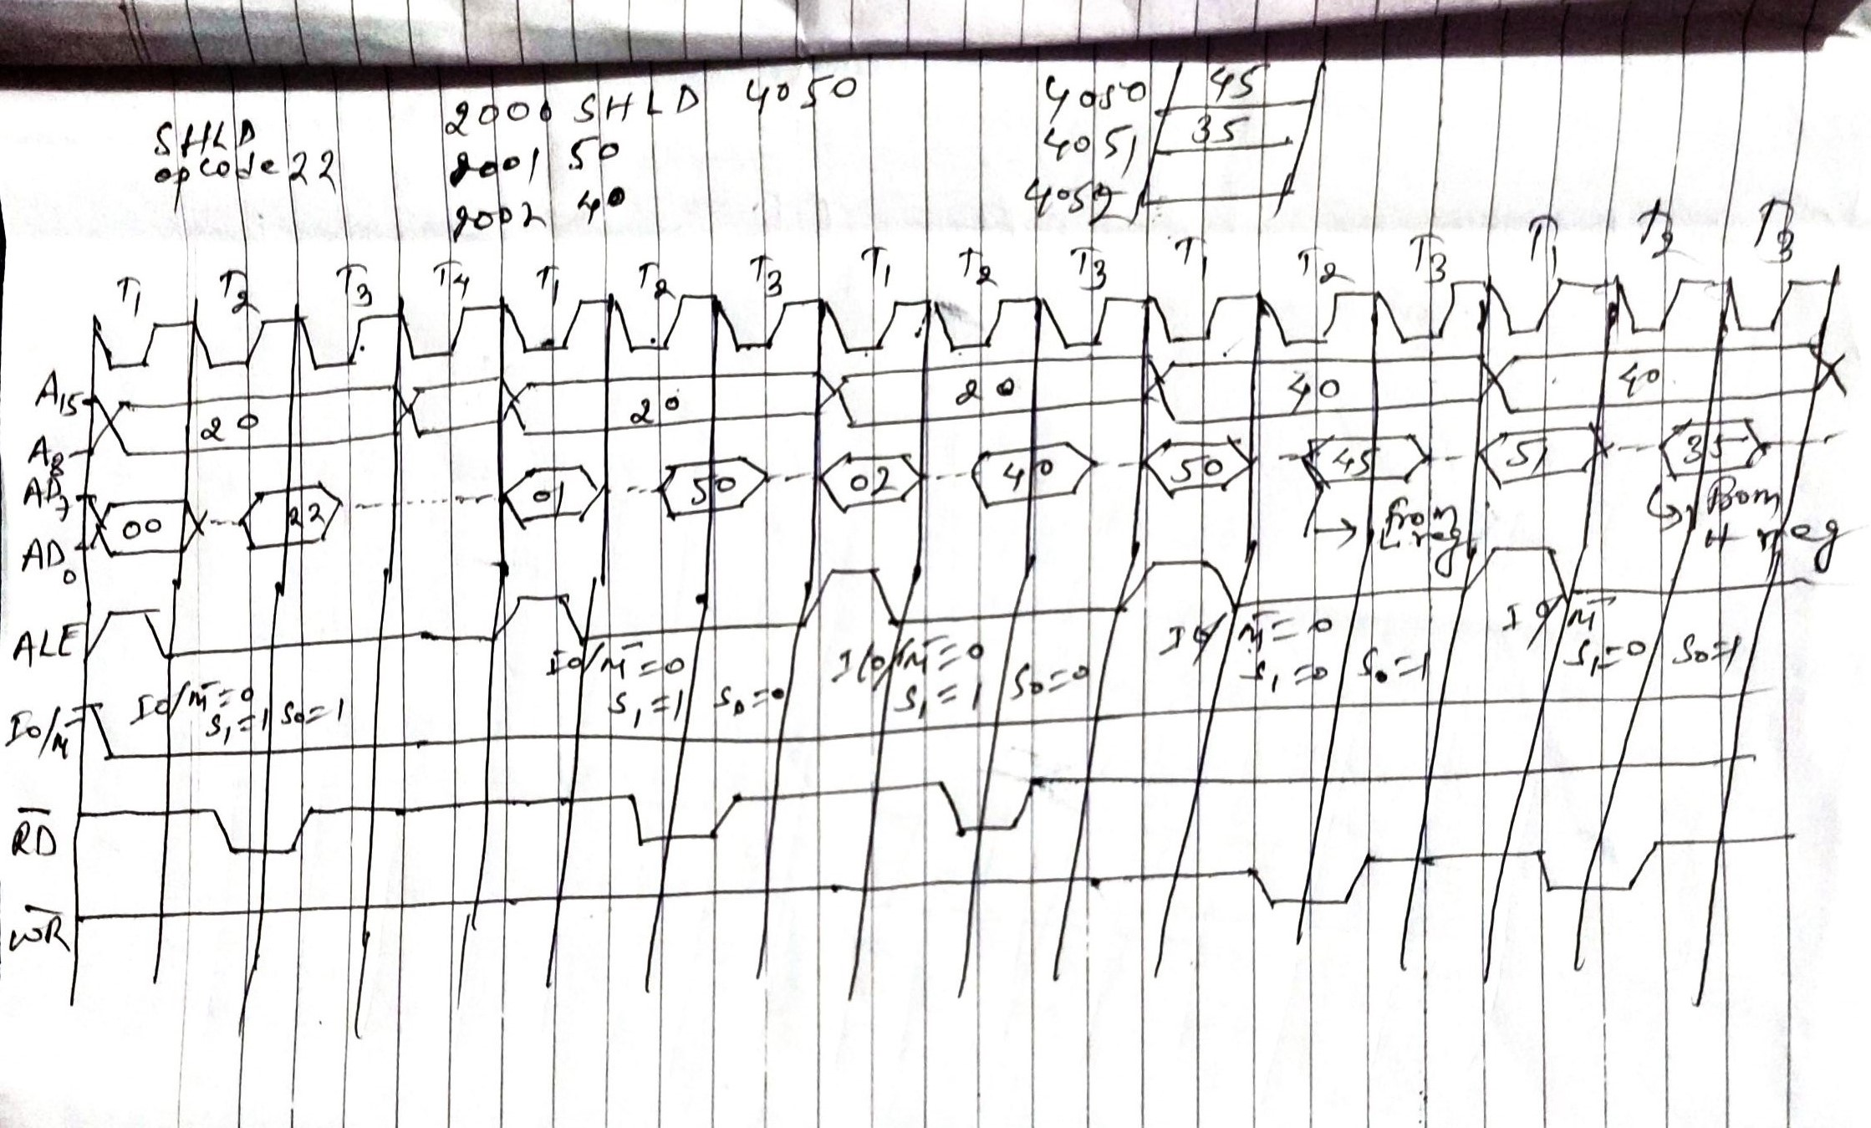
Microprocessor……..

Slide 3
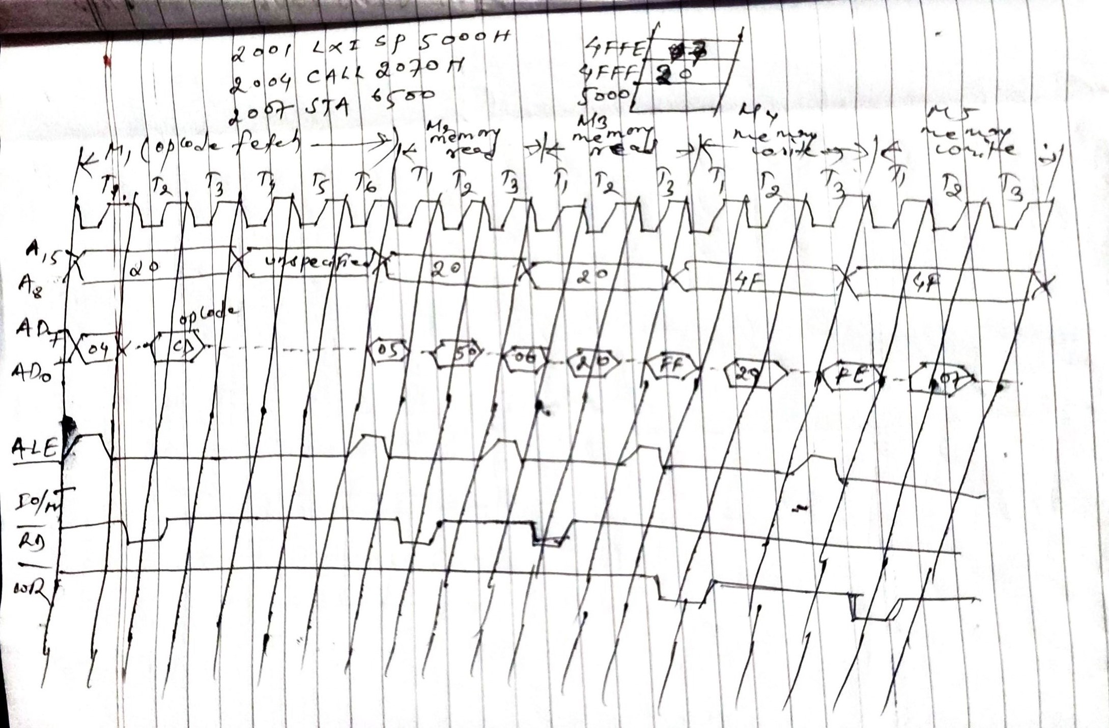
Microprocessor……..

Slide 4
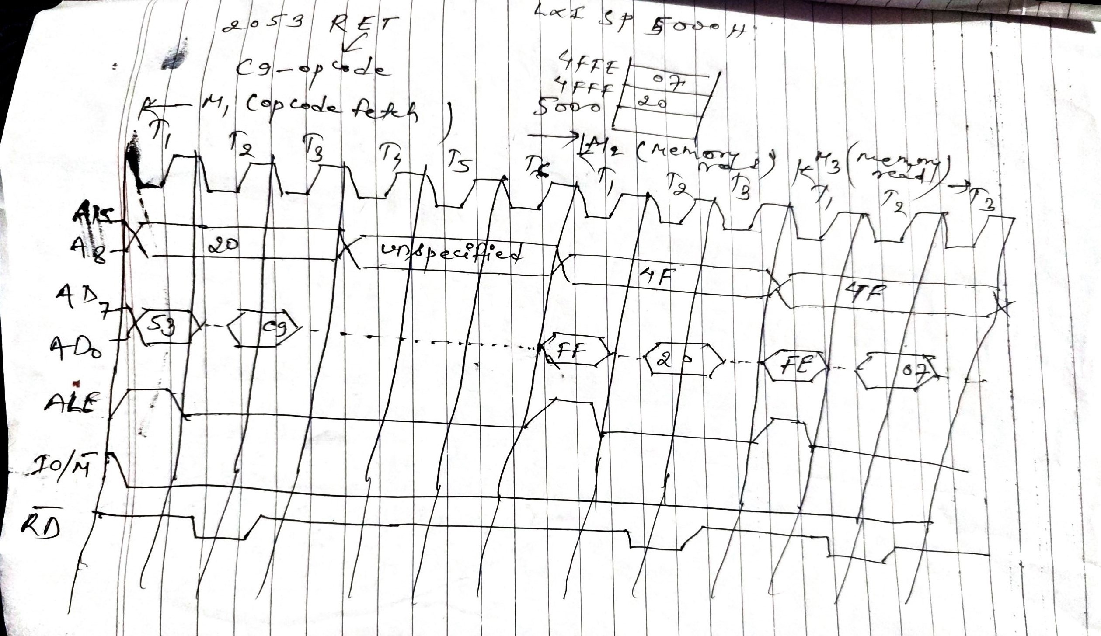
Microprocessor……..

Slide 5
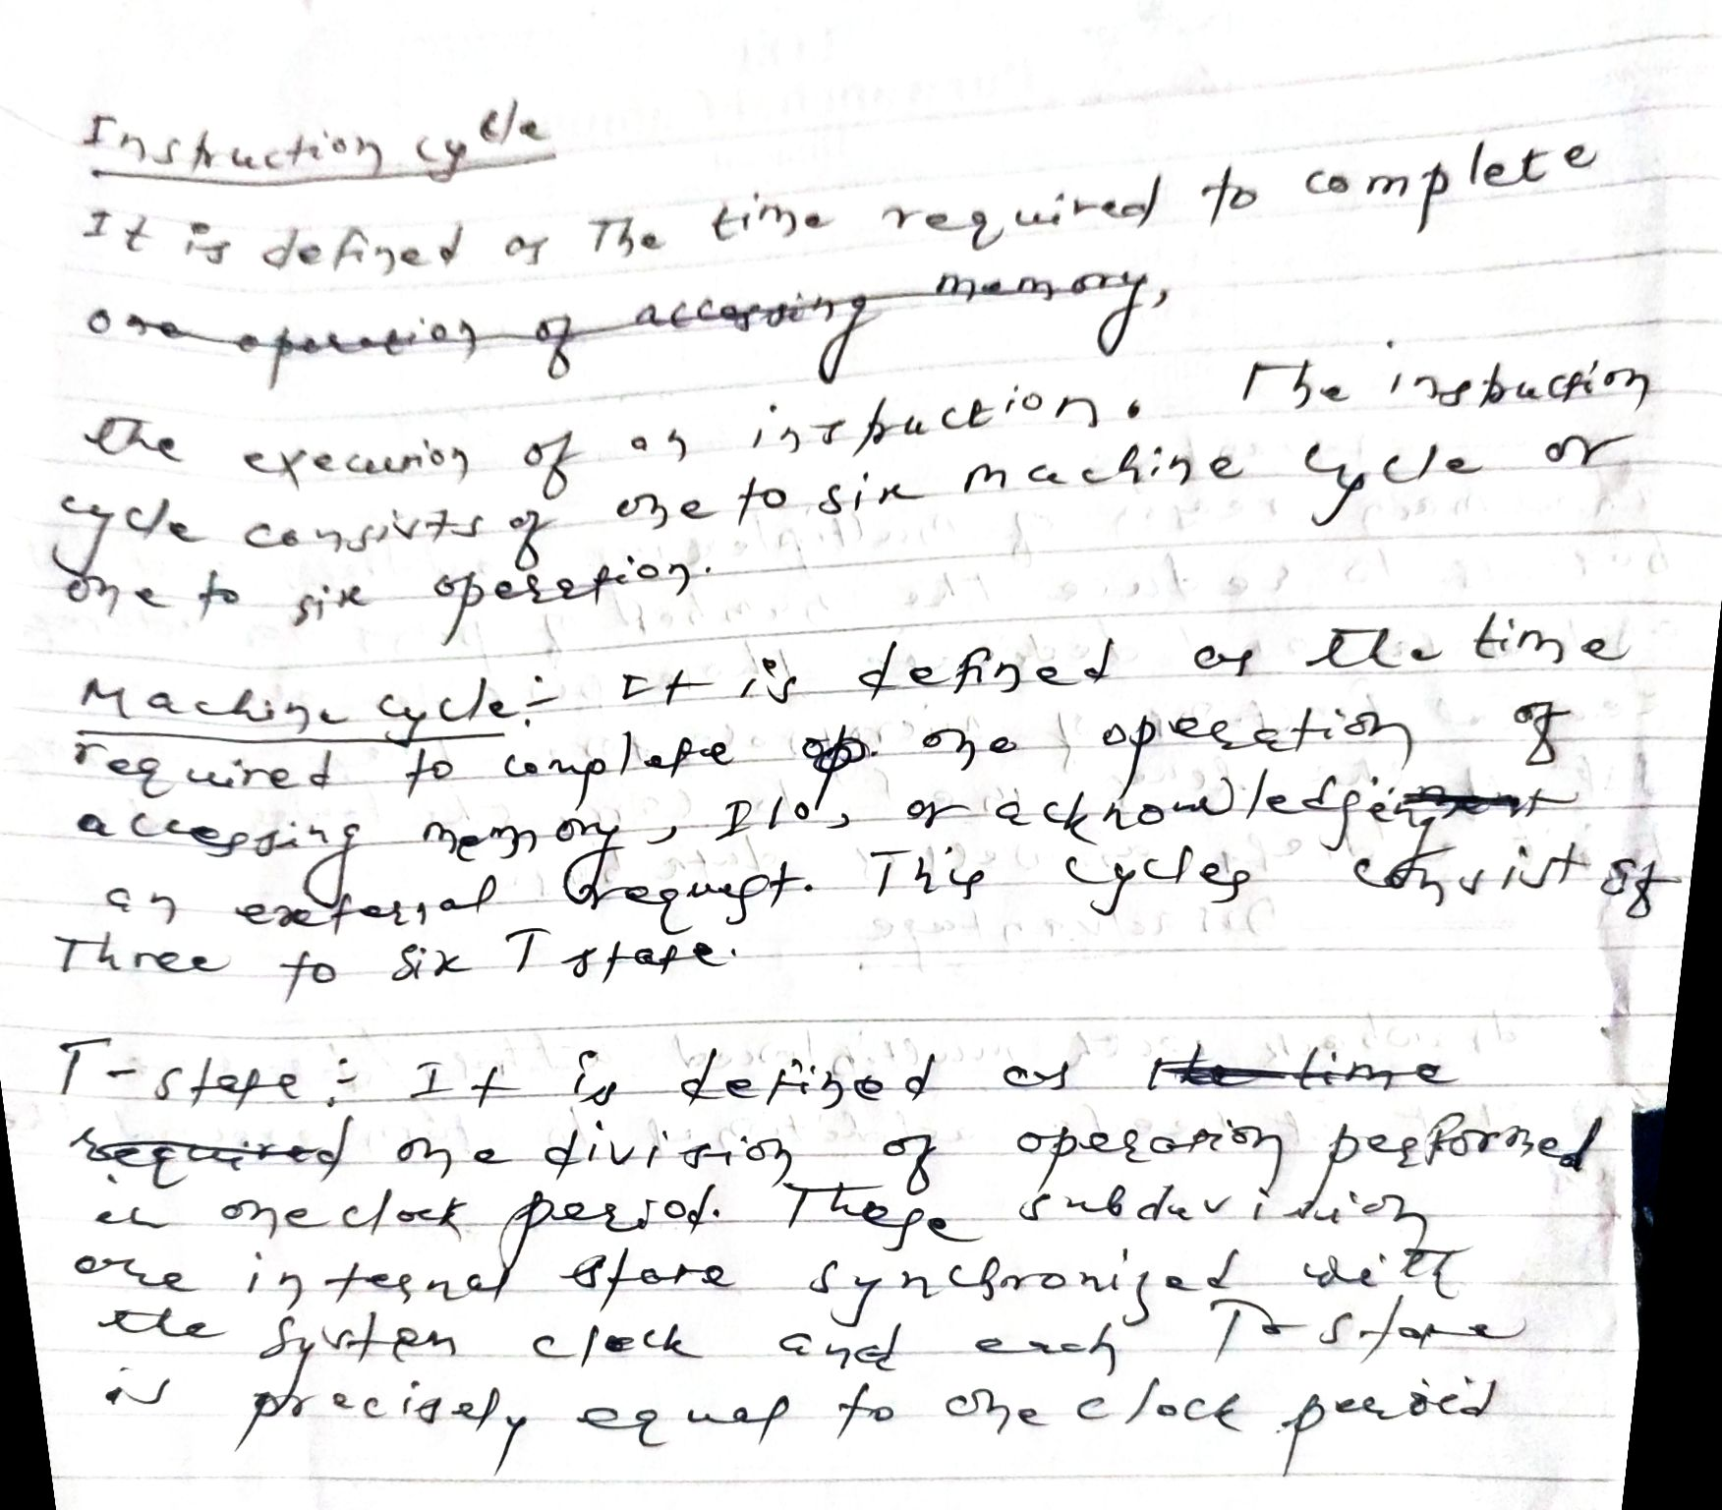
Microprocessor……..

Slide 6
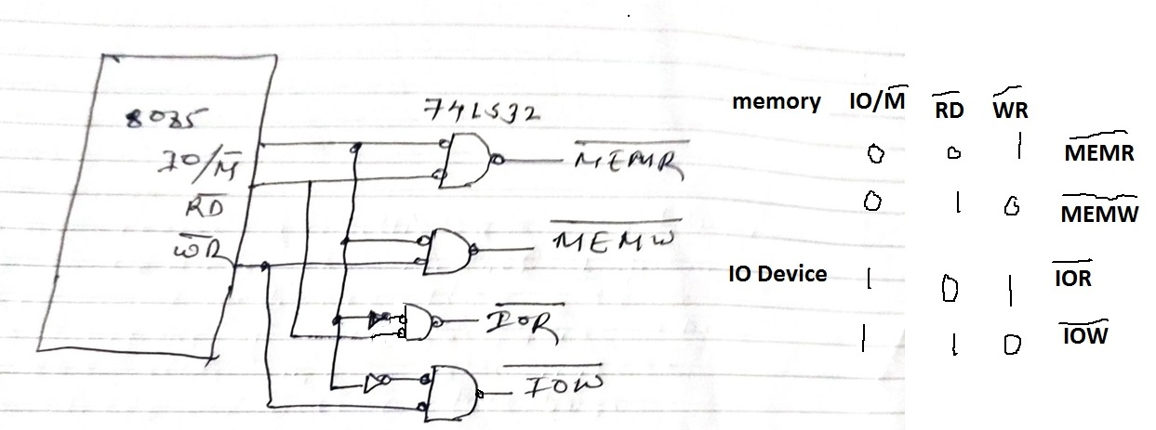
Microprocessor……..

Slide 7
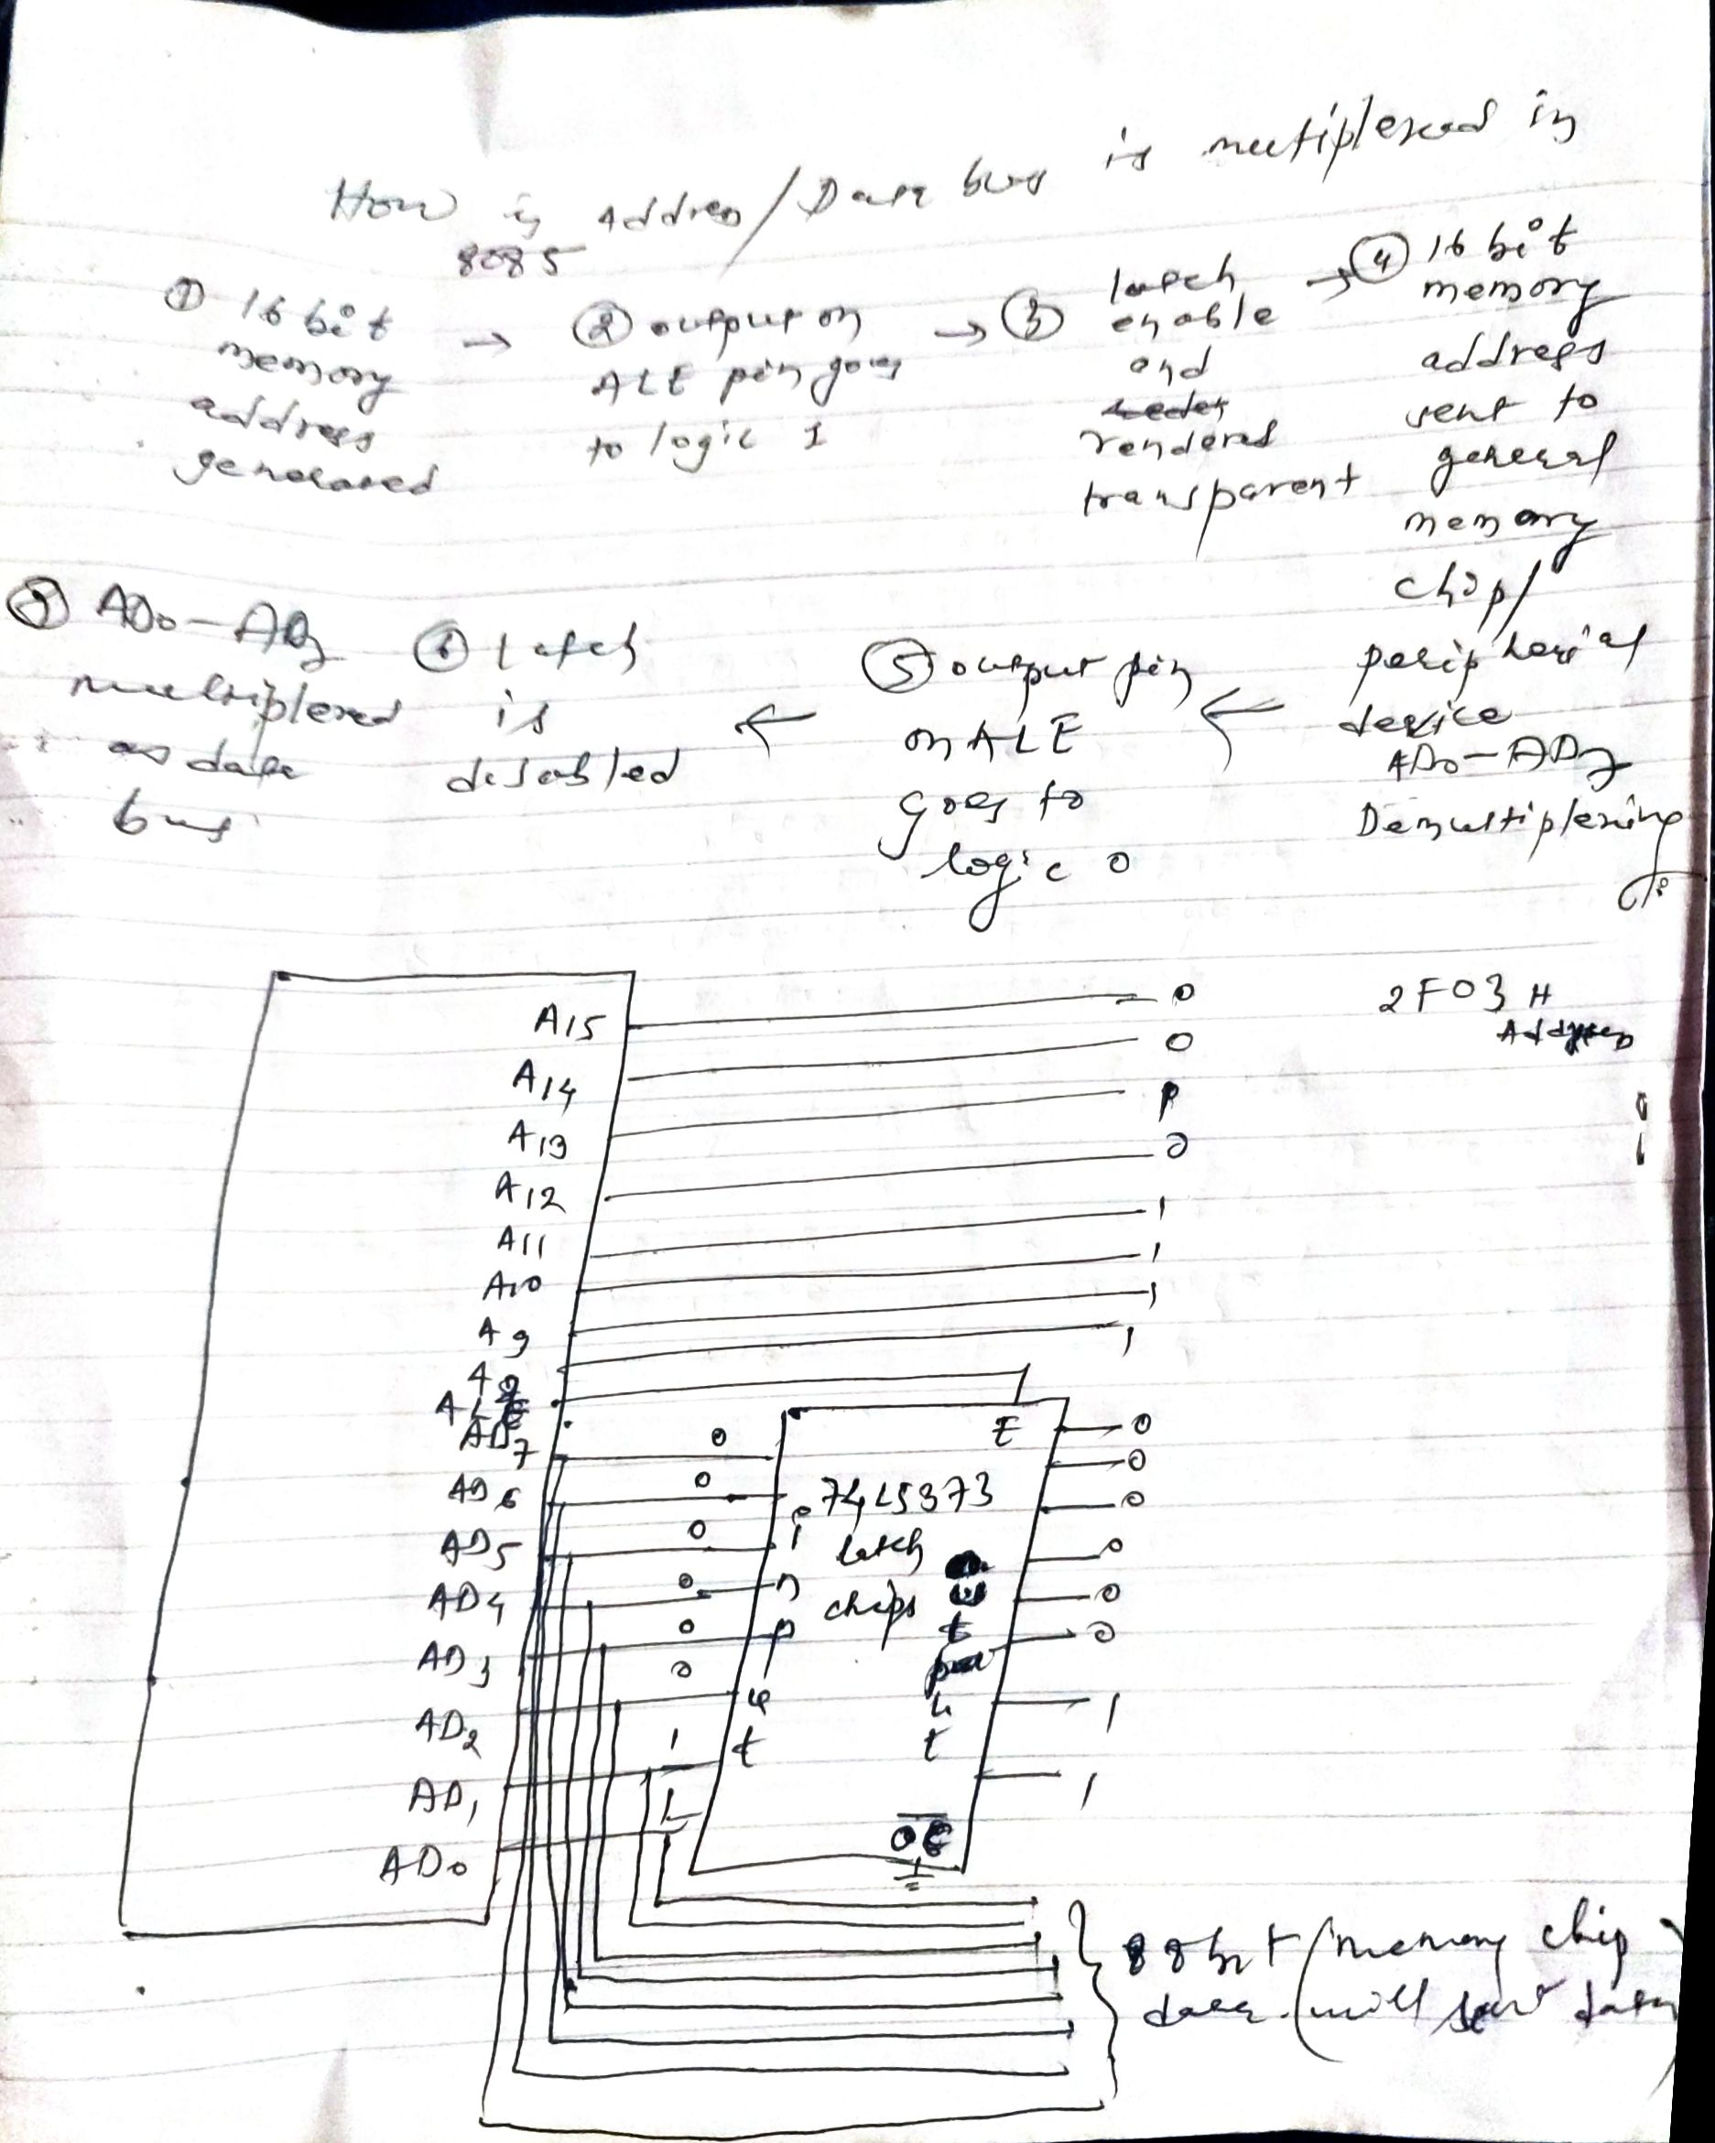
Microprocessor……..

